Slide 1


Team QuadZen
FinAI Navigate
Revolutionizing Loan Paths with Smart Approval Systems

Slide 2




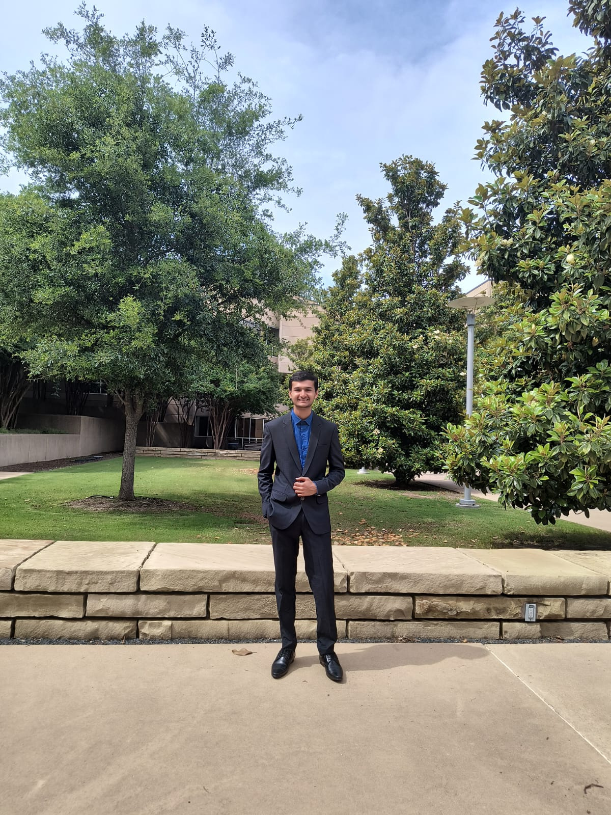


Our Members
Team QuadZen
Pranav Mody
Pritul Dave
Samved Sangle
Subhash Gannamraju
MS IN INFORMATION TECHNOLOGY AND MANAGEMENT
MS IN COMPUTER SCIENCE
MS IN INFORMATION TECHNOLOGY AND MANAGEMENT
MS IN BUSINESS ANALYTICS

Slide 3

PROBLEM
Team QuadZen
In today's financial landscape, the loan application process remains daunting, opaque, and inaccessible for many. Applicants face numerous hurdles, such as understanding eligibility criteria, the complexity of navigating various loan types, and the discouragement following a loan rejection.
This complexity not only hinders individuals' ability to access necessary financial support but also contributes to a wider gap in financial literacy and empowerment.

Slide 4
SOLUTION
Team QuadZen
Machine Learning Algorithms: Our model uses a sophisticated algorithm to analyze an individual’s financial data, credit history, and other relevant factors in real-time, predicting loan eligibility with a high degree of accuracy.
Dynamic Decision Engines: By integrating machine learning, our system adapts and learns from each application, continuously refining its criteria and predictions to improve accuracy over time.
Automated Feedback Loops: For applicants not approved, our system generates detailed, personalized feedback based on the analysis, offering clear steps for improvement and future success.
API Integrations with Financial Institutions:Seamless connectivity with banking partners ensures that once a loan is deemed viable, the transition from application to approval is swift and smooth.

Slide 5

Team QuadZen
Our Vision
To revolutionize the loan approval process with AI-driven insights, making financial support more accessible, personalized, and efficient. We aim to empower individuals with the knowledge and tools they need to navigate their financial journeys successfully.
Through innovation and empathy, we aim to build a future where financial well-being is accessible to all, turning aspirations into attainments.

Slide 6














TECH STACK

Slide 7








Our Features:
Real-Time
Eligibility Analysis
Transparent
Data Handling
Comparison
Amongst Banks
Personalized
Loan Matching
Actionable Insights for Financial Growth
Dynamic
Feedback System
Automated
Documentation
Processing
User-Friendly Interface

Slide 8
Process: Data Cleaning and Pre Processing
Column Removal: Utilize df.drop(columns=cols_toRemove) to discard non-essential features, optimizing data structure for machine learning efficiency.
2.Categorical Variable Encoding: Apply pd.get_dummies(df, columns=categorical_cols) for transforming categorical features into binary vectors, facilitating algorithmic processing.
3.Numeric Conversion of Ranges: Execute str.split() and .astype(float) on asset range data to bifurcate and numerically encode ranges, enabling quantitative analysis.
4.Numeric Mapping of Target Variable: Implement df['Loan Status'].map(class_map) to translate categorical outcomes into numeric codes (0, 1), aligning with ML model input requirements.
5.Feature Standardization: Employ StandardScaler() to normalize feature distributions, crucial for maintaining consistency across model inputs and optimizing neural network performance.
Team QuadZen

Slide 9
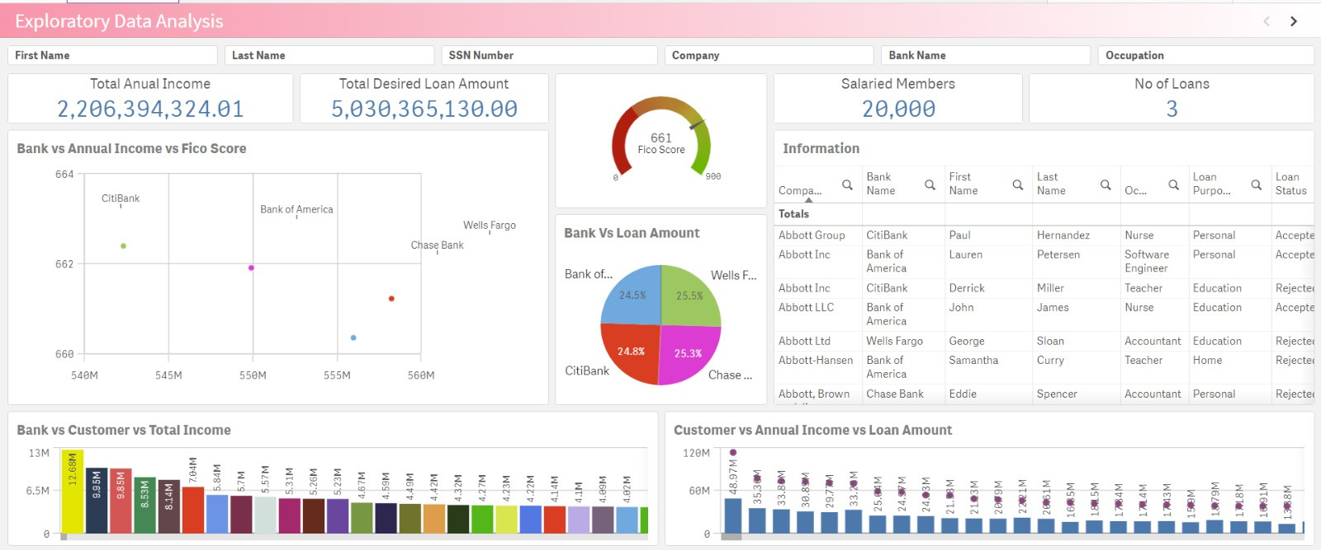
Process: Exploratory Data Analysis (EDA))
Team QuadZen

Slide 10
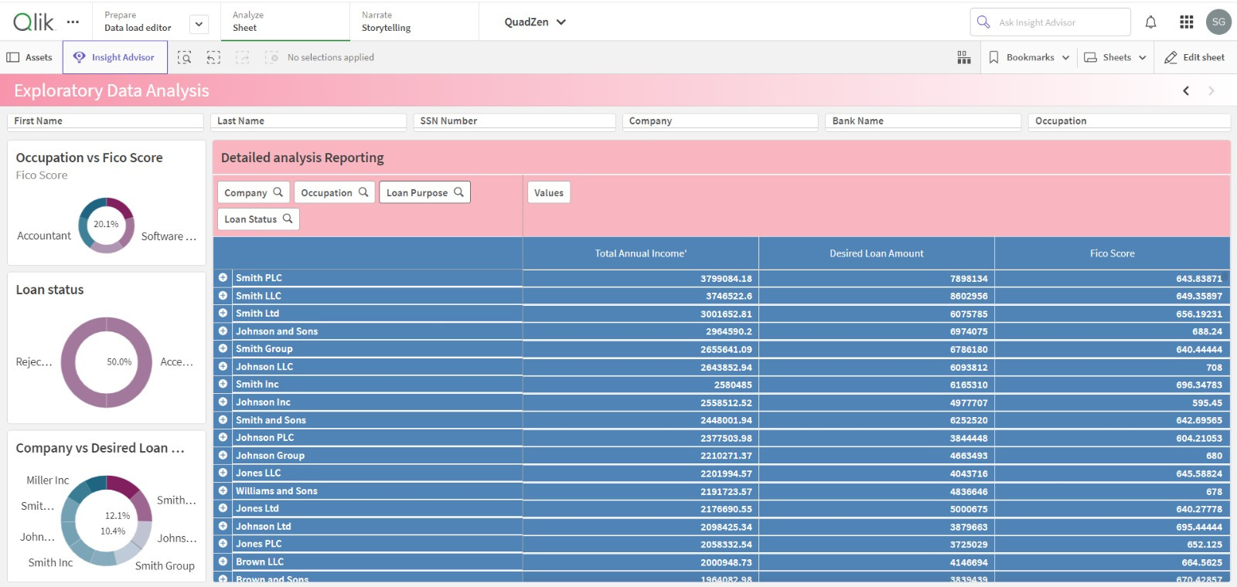
Process: Exploratory Data Analysis (EDA))
Team QuadZen

Slide 11
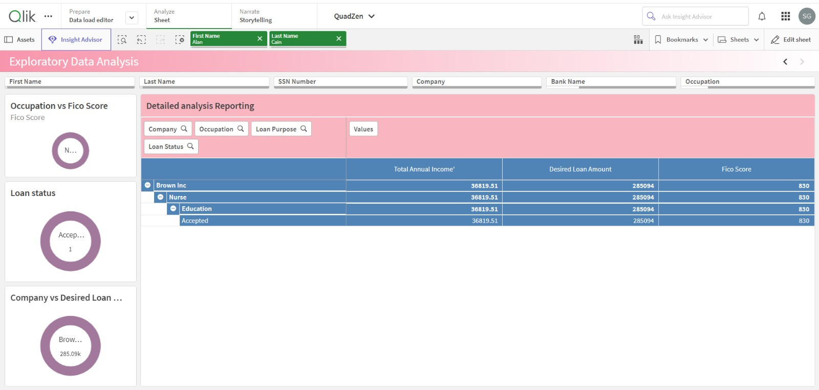
Process: Exploratory Data Analysis (EDA))
Team QuadZen

Slide 12
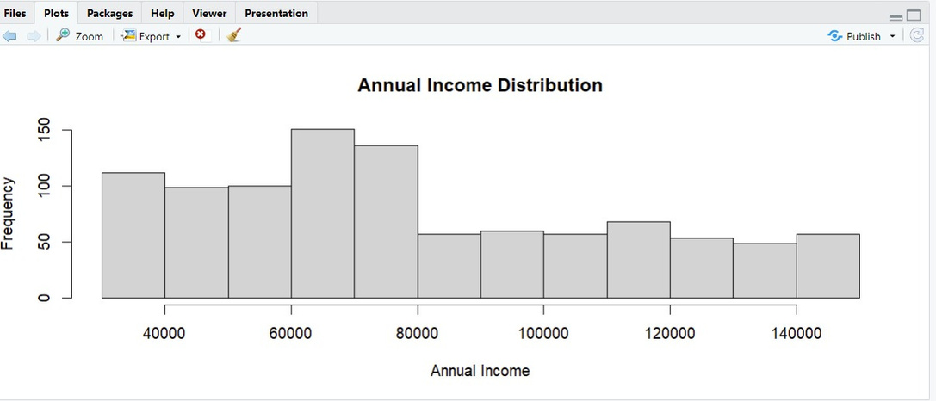
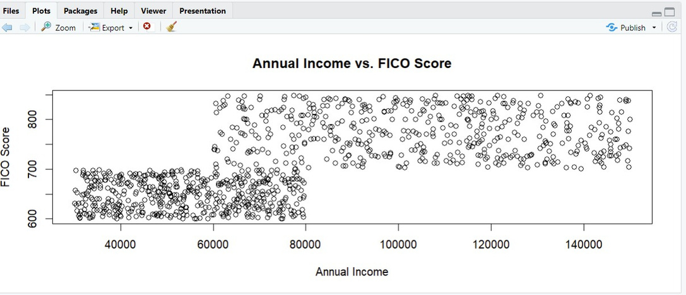
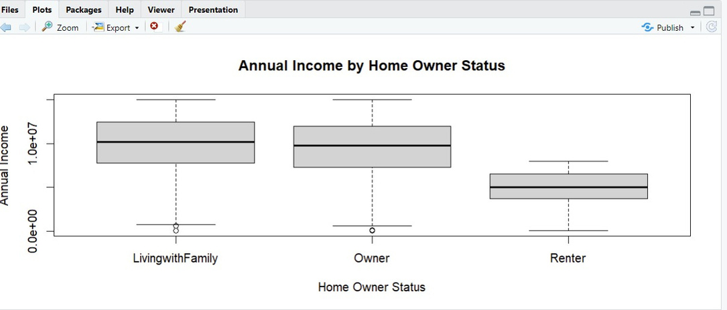
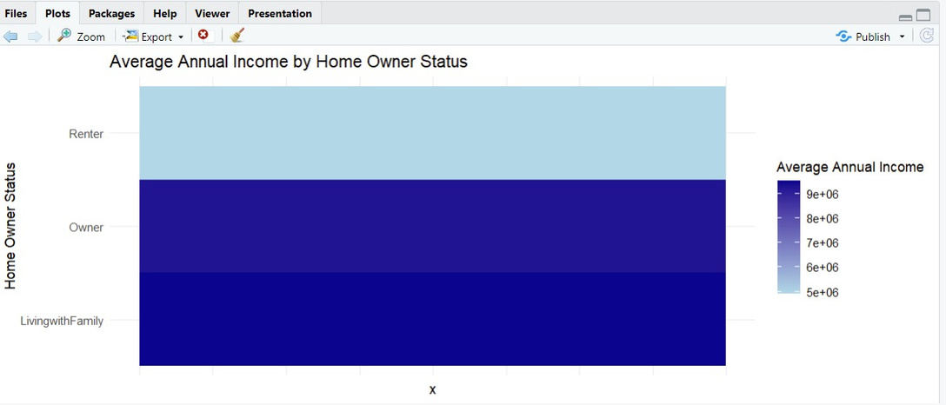
Process: Exploratory Data Analysis (EDA))
Team QuadZen

Slide 13
Process: Algorithm and Technology
Algorithm: Multi-Layer Perceptron (MLP) Classifier
Configuration:
Hidden Layers: 1 layer with 10 neurons
Max Iterations: 300 to ensure convergence
Random State: 42 for reproducible results
Training Process:
The model is trained using scaled features to enhance prediction accuracy.
Utilizes backpropagation to optimize weights and biases.
Prediction & Evaluation:
The model predicts loan approval outcomes on a test dataset.
Evaluation through accuracy score, measuring the percentage of correctly predicted instances.
Result: The accuracy score of 81.4% indicates the model's effectiveness in classifying loan approvals accurately.
Team QuadZen

Slide 14
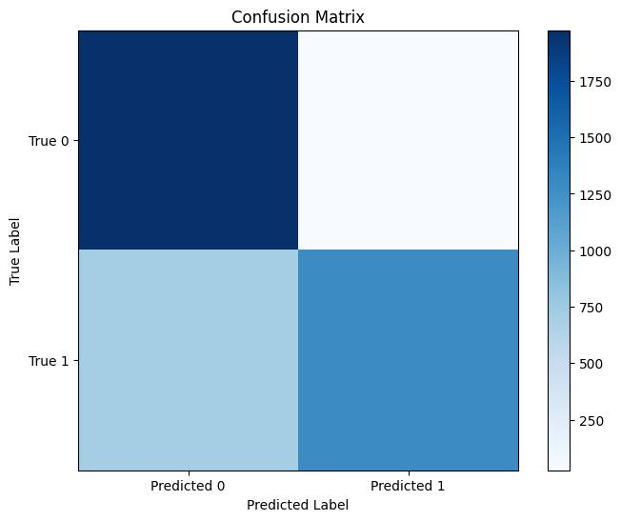
Results of Algorithm:
Team QuadZen

Slide 15
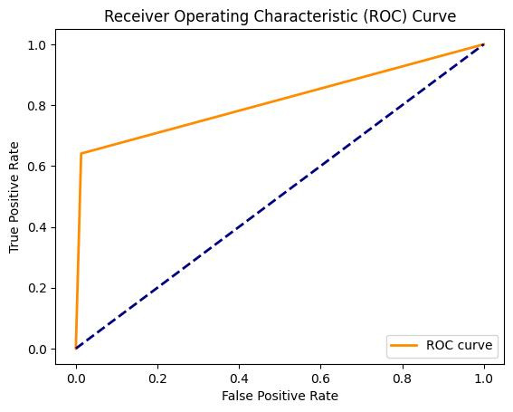
Results of Algorithm:
Team QuadZen

Slide 16
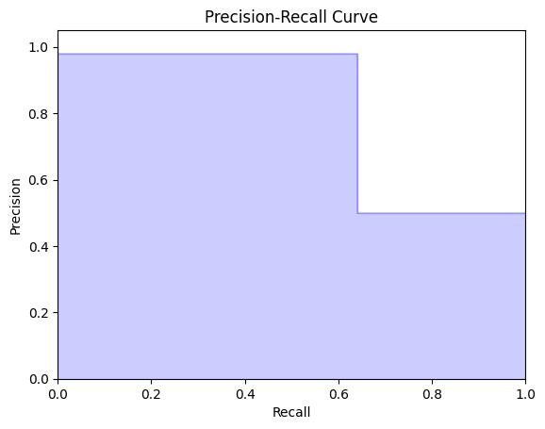
Results of Algorithm:
Team QuadZen

Slide 17
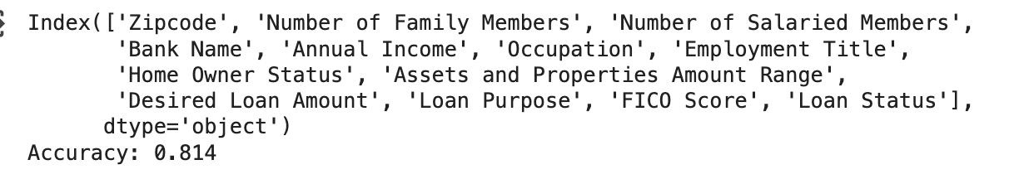
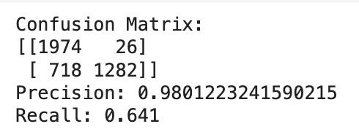
Results of Algorithm:
Based on these differentiating parameters:
Team QuadZen

Slide 18
Dataset :
https://loandata2020.s3.us-west-1.amazonaws.com/detailed_us_records_20k.csv
Model Link:-
https://colab.research.google.com/drive/1hXuwo0EWpaVovC4ikXQNpxGt6u2uJh0I?usp=sharing

Slide 19

Thank You!

